Slide 1
Generating Functions
by
Dr. T. M. Rajalaxmi
Assistant Professor
Department of Mathematics

Slide 2
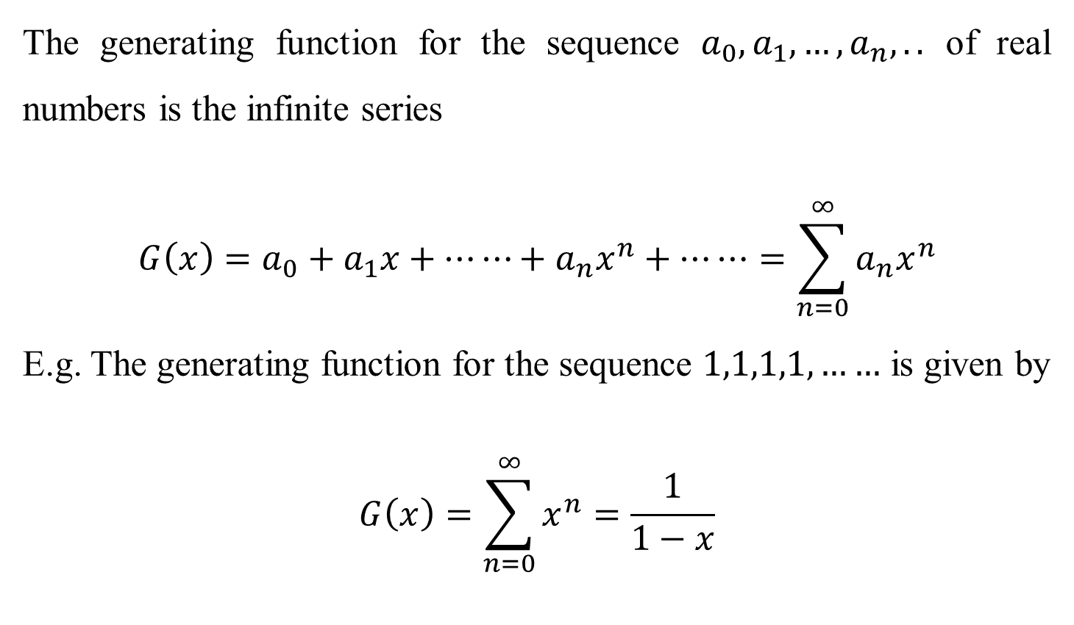
Definition
The generating function for the sequence $a_{0},a_{1},…,a_{n},..$ of real numbers is the infinite series
$$G\left(x\right)=a_{0}+a_{1}x+⋯⋯+a_{n}x^{n}+⋯⋯=\sum_{n=0}^{∞}{a_{n}x^{n}}$$
E.g. The generating function for the sequence $1,1,1,1,……$ is given by
$$G\left(x\right)=\sum_{n=0}^{∞}{x^{n}}=\frac{1}{1−x}$$

Slide 3

Problems
Find the generating function for the following sequence
(i) $2^{0},2^{1},2^{2},…,2^{r}$ (ii) 7,-4,3,0,1
(i) $G\left(x\right)=1+2x+2^{2}x^{2}+…+2^{r}x^{r}=\sum_{n=0}^{∞}{{\left(2x\right)}^{n}}$
(ii)$G\left(x\right)=7−4x+3x^{2}+x^{4}$

Slide 4
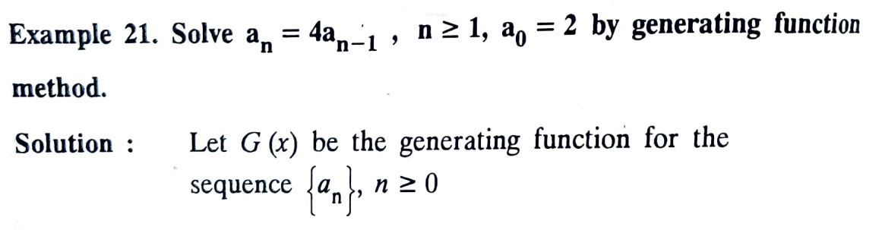
Problems

Slide 5
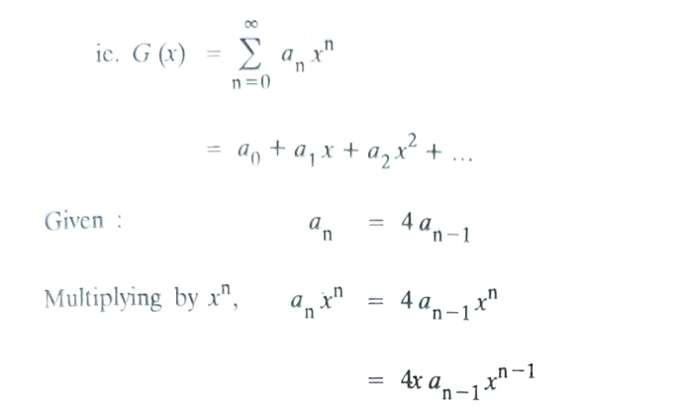
Problems

Slide 6
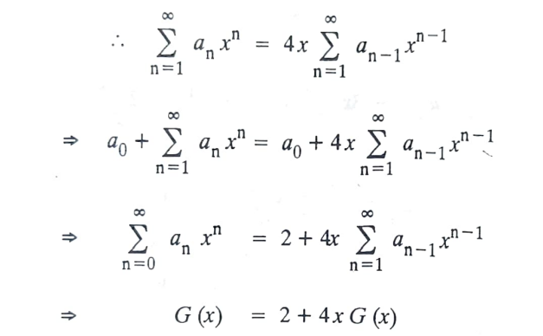
Problems

Slide 7
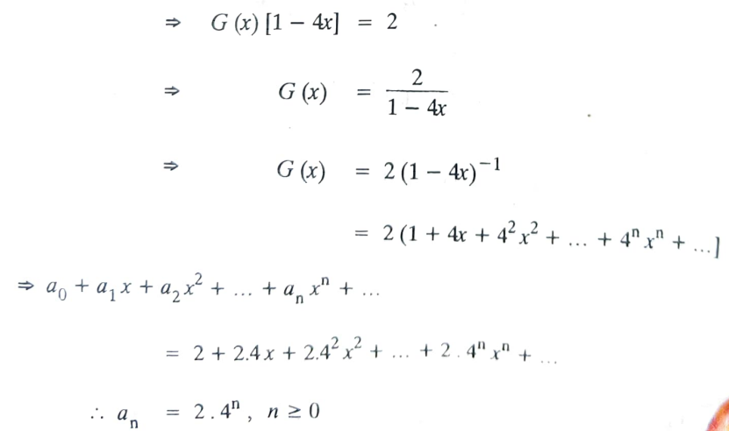
Problems

Slide 8
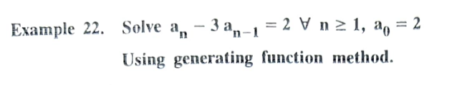
Problems

Slide 9
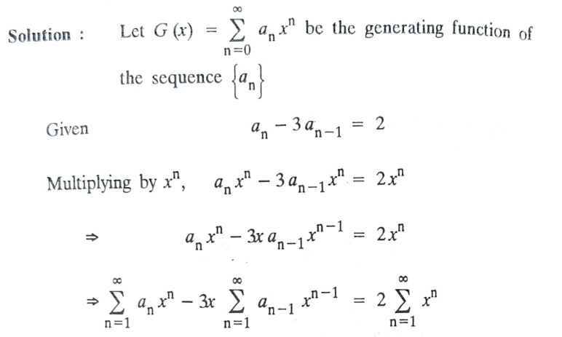
Problems

Slide 10
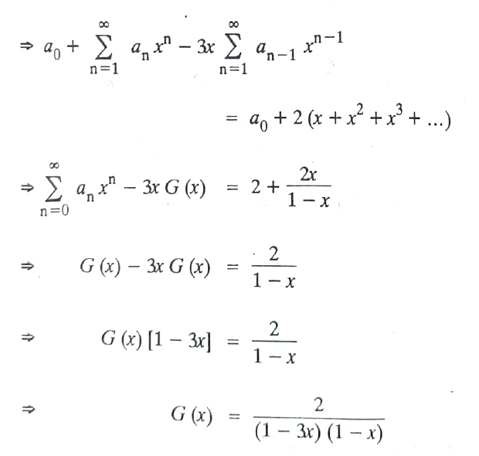
Problems

Slide 11
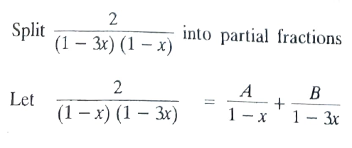
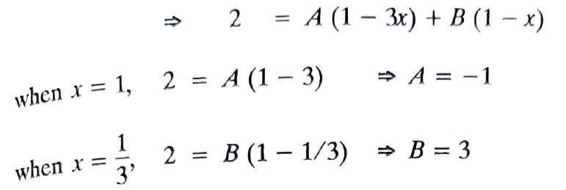
Problems

Slide 12
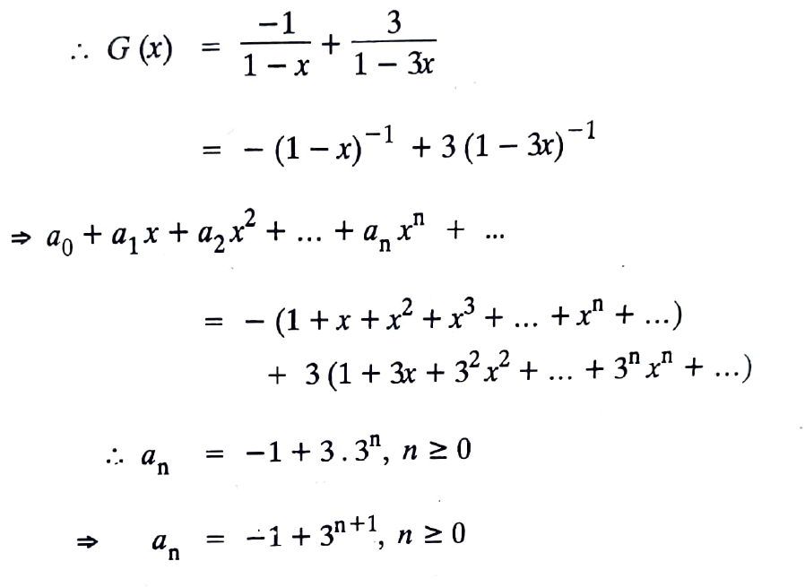
Problems

Slide 13
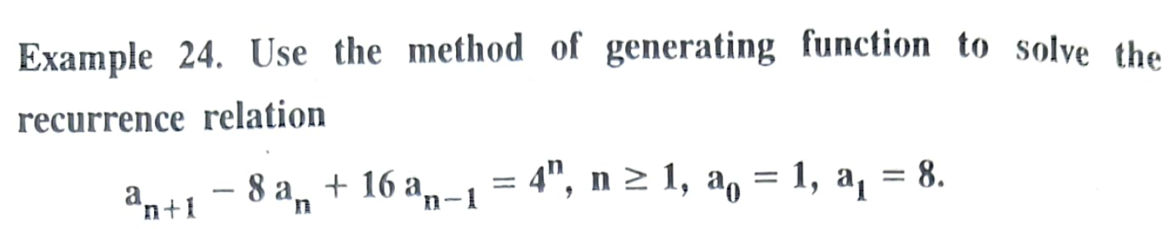
Problems

Slide 14
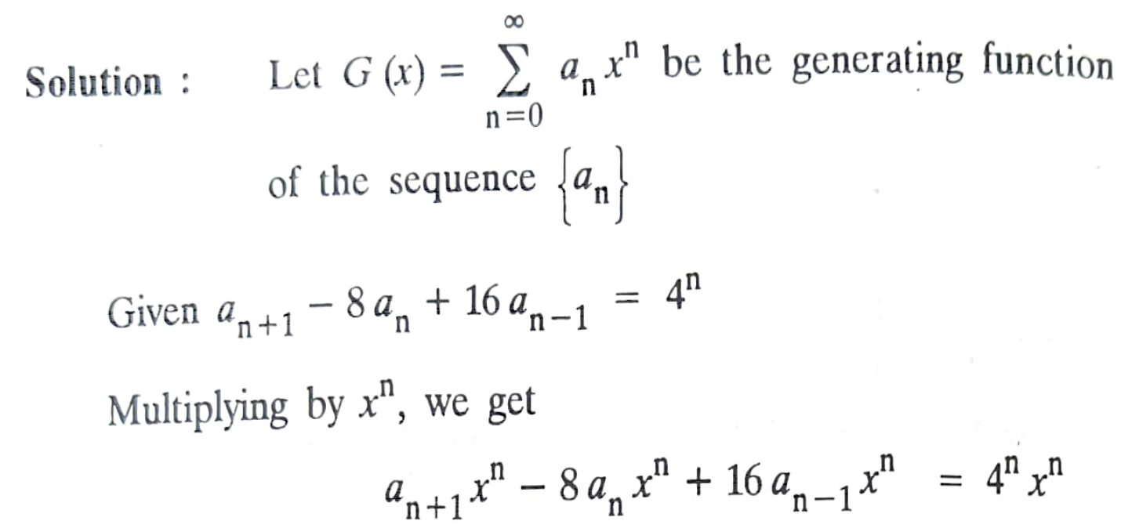
Problems

Slide 15
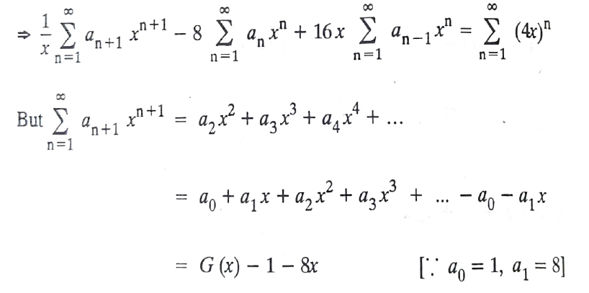
Problems

Slide 16
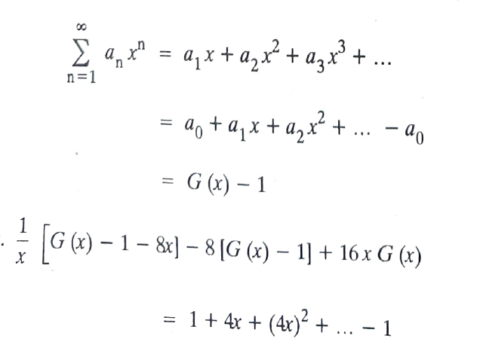
Problems

Slide 17
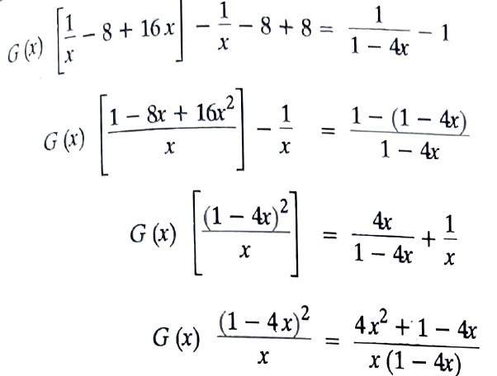
Problems

Slide 18
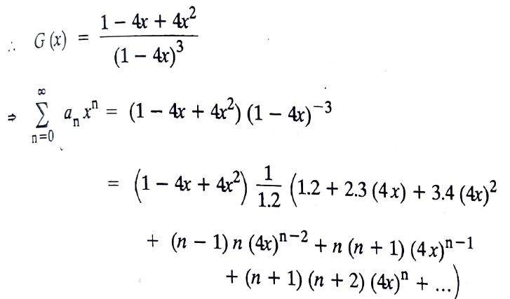
Problems

Slide 19
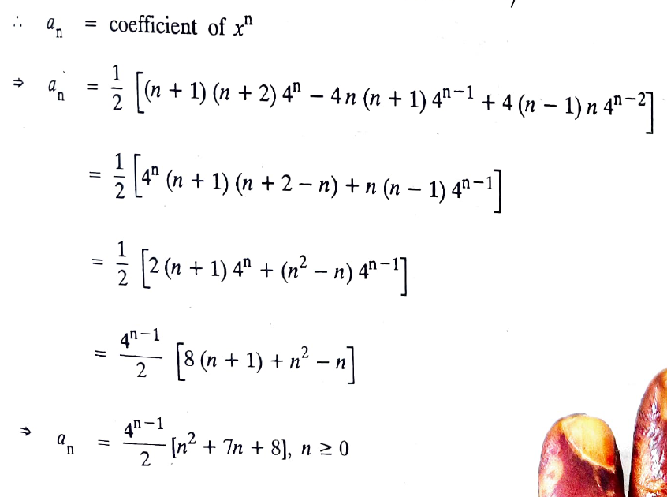
Problems

Slide 20
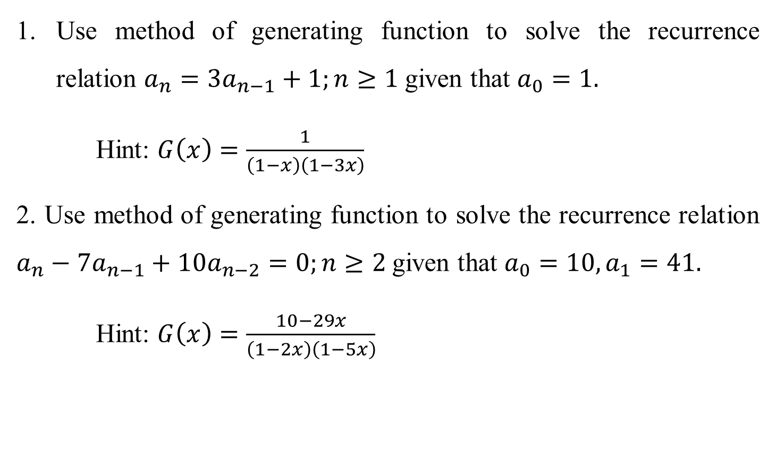
Problems
Use method of generating function to solve the recurrence relation $a_{n}=3a_{n−1}+1;n≥1$given that $a_{0}=1.$
Hint: $G\left(x\right)=\frac{1}{\left(1−x\right)\left(1−3x\right)}$
2. Use method of generating function to solve the recurrence relation $a_{n}−7a_{n−1}+10a_{n−2}=0;n≥2$given that $a_{0}=10,a_{1}=41.$
Hint: $G\left(x\right)=\frac{10−29x}{\left(1−2x\right)\left(1−5x\right)}$

Slide 21
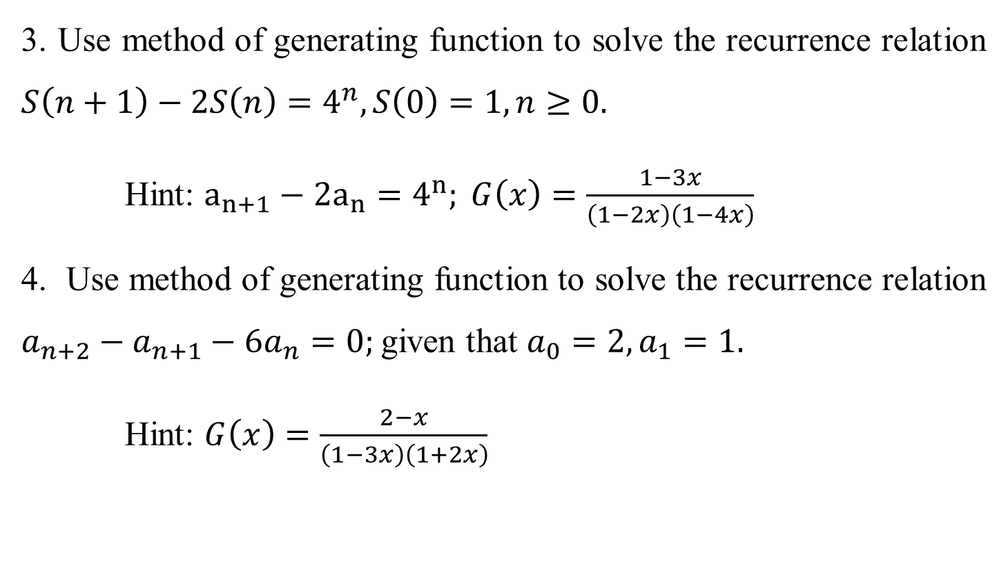
Problems
3. Use method of generating function to solve the recurrence relation $S\left(n+1\right)−2S\left(n\right)=4^{n}, S\left(0\right)=1, n≥0.$
Hint: $a_{n+1}−2a_{n}=4^{n}; G\left(x\right)=\frac{1−3x}{\left(1−2x\right)\left(1−4x\right)}$
4. Use method of generating function to solve the recurrence relation $a_{n+2}−a_{n+1}−6a_{n}=0;$given that $a_{0}=2,a_{1}=1.$
Hint: $G\left(x\right)=\frac{2−x}{\left(1−3x\right)\left(1+2x\right)}$

